Slide 1

Serverless
Function-as-a-Service
Milco Numan
FaaS
Notes:
Faas Wilkes @ Inter Milan

Slide 2
Spoorboekje
16.00 Inloop
16.30 Presentatie Serverless
17.15 Hands-on Serverless
18.00 Diner buffet
18.45 Vervolg hands-on
20.00 Afsluiting

Slide 3

GEEN Servers?
It is not about NO servers …
Just that you do not have to care about them.

Slide 4
Programma
Introductie
Wat is Serverless?
Voor- en nadelen
Toepassingmogelijkheden
Serverlozen (implementaties van ‘Serverless’)
AWS
Wat gaan we tegenkomen
Gratis?
Demo
Workshop inhoud hands-on
Vragen?

Slide 5
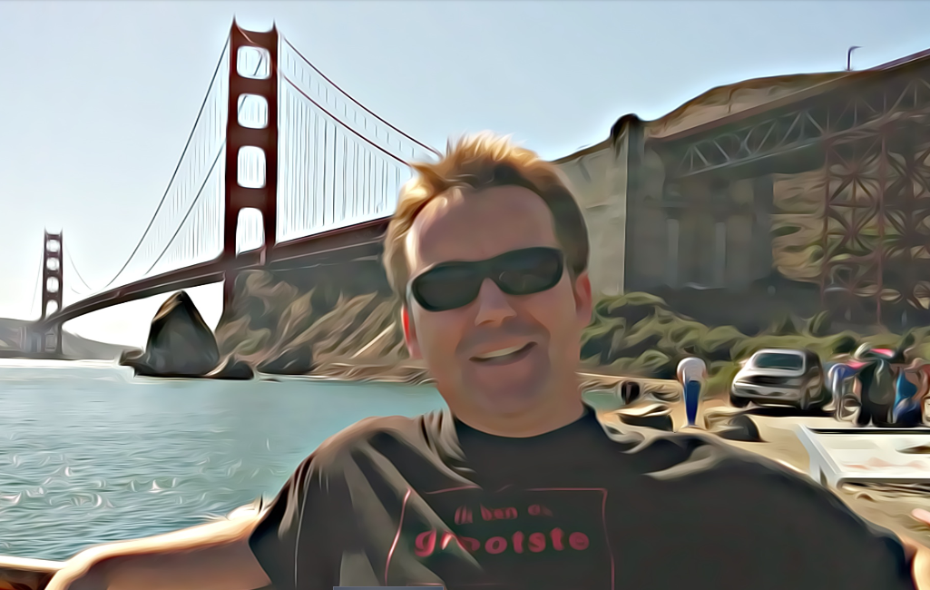
Introductie
Milco Numan (1969)
Fysische Chemie (UvA, 1993)
IT sinds 1996:
Rijkscomputer Centrum (Borland Delphi)
Serac (BaaN custom development)
Oracle Nederland (ERP, Middleware, OHI)
Qualogy (Oracle Middleware)
SynTouch (Oracle Middleware)
Cloud:
CloudSchool Certified Cloud Architect
Amazon Solution Architect Associate
Amazon Developer Associate

Slide 6
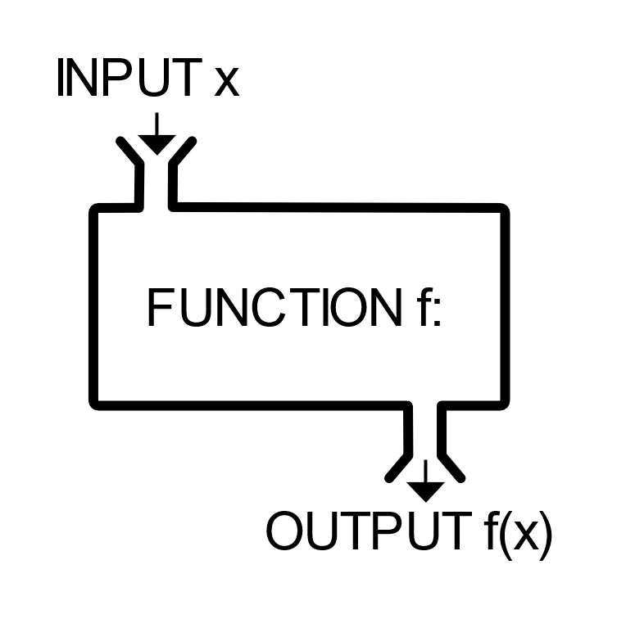
Function-as-a-Service (FaaS)
“Custom code (functions) run in ephemeral containers” (Mike Roberts – martinfowler.com/articles/serverless.html)
Functie – eenduidig/welgedefinieerd
domein (input)
bereik (output)
relatie (bewerking)
FaaS is fundamentally about running backend code without managing your own systems or your own long-lived server applications.

Slide 7
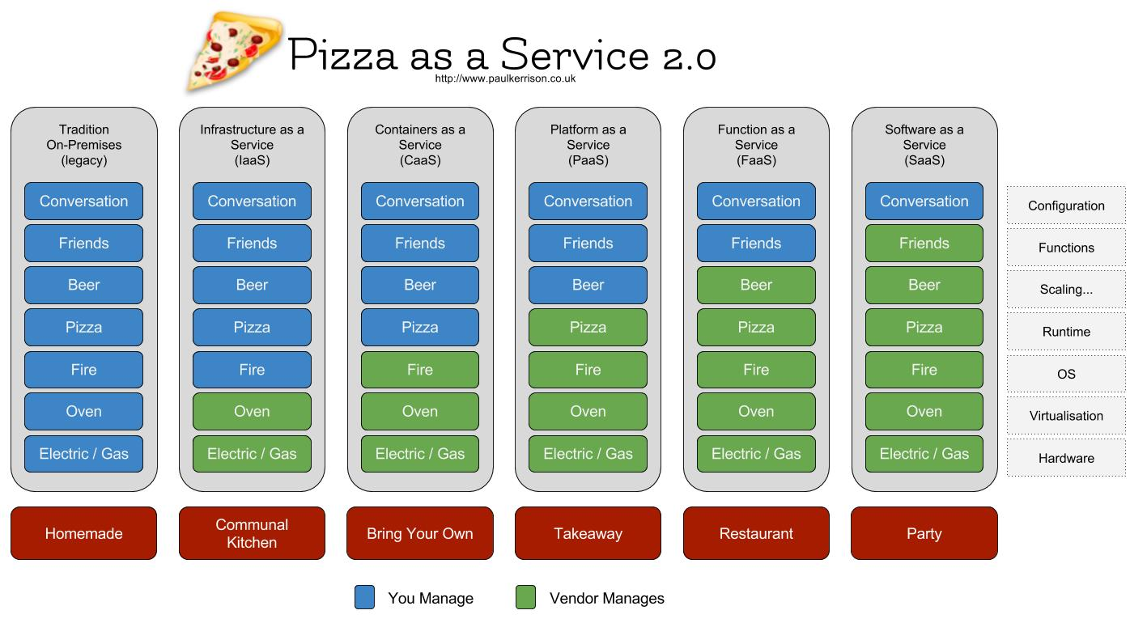
FaaS in het “Cloud Continuum”
http://www.paulkerrison.co.uk/random/pizza-as-a-service-2-0

Slide 8

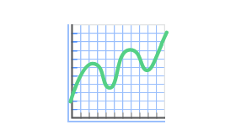
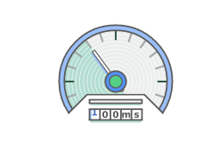
Serverless = Cloud 2.0!
No servers to manage – just code
No monoliths, just simple functions
Auto-scaling
Never pay for idle, pay per execution!

Slide 9
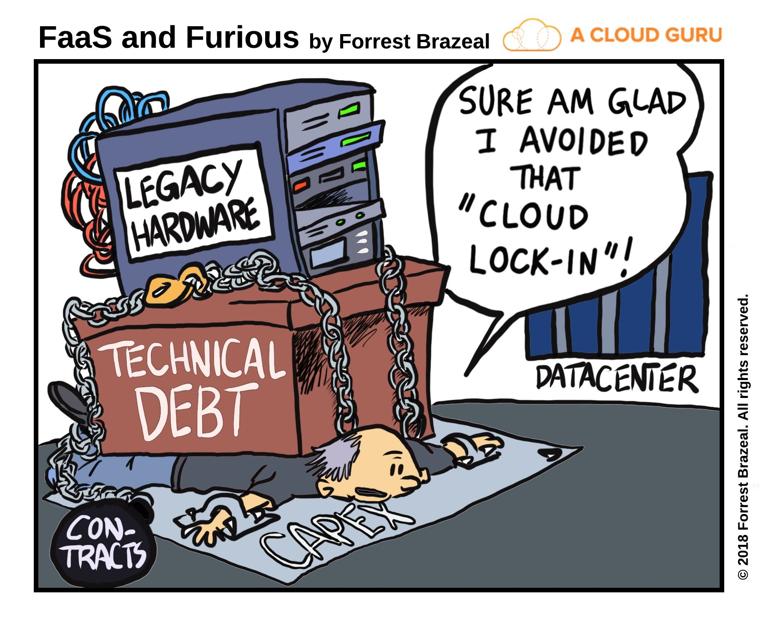



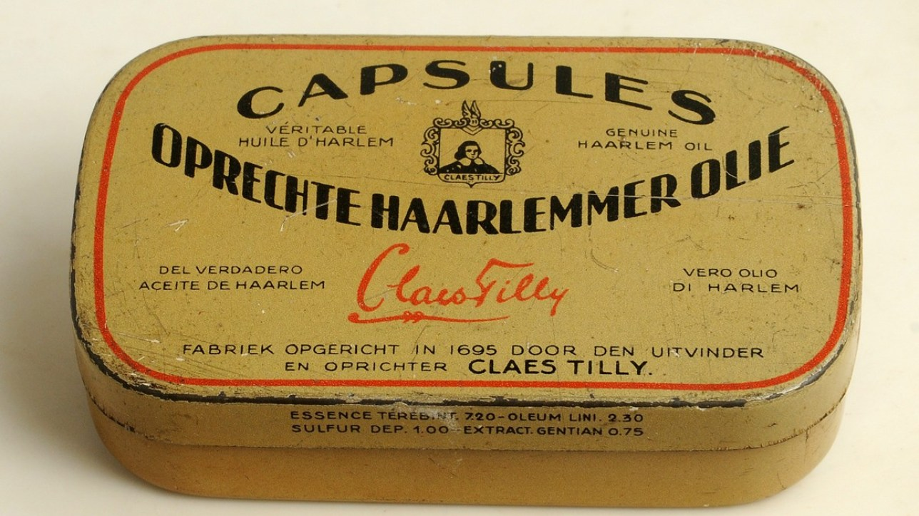

Nadelen
Toestand wordt niet bewaard
Grenzen aan duur/geheugengebruik (AWS: 5 min/3008 MB)
Koude start
Cloud lock-in
DynamoDB
AWS Step Functions
Amazon Simple Workflow

Slide 10
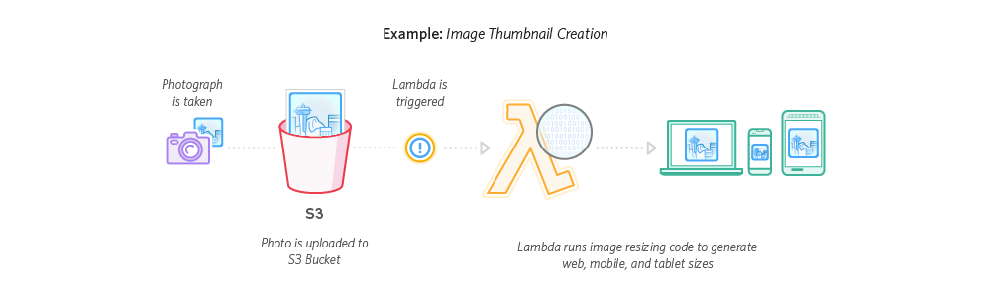
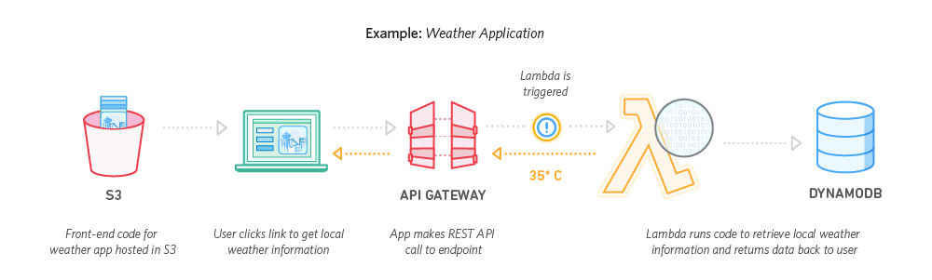
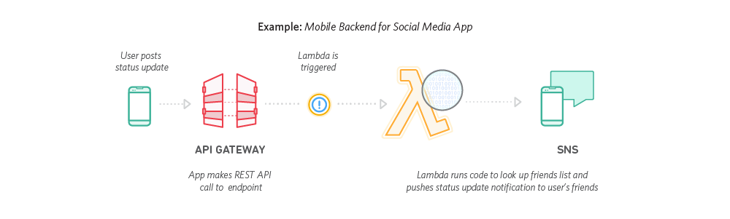
Toepassingsmogelijkheden

Slide 11



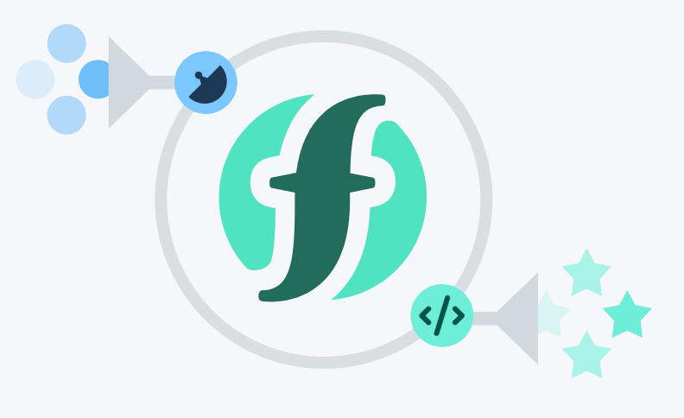
Serverlozen - Platformen
AWS Lambda
Runtimes: Node.js, Python 2/3, Java 8, C#, Go
Azure Functions
Runtimes: C#, F#, Node.js, +experimental
Google Cloud Functions
Runtimes: Node.js, Python 3
IBM Cloud Functions
Runtimes: JavaScript, Python 2/3, PHP, Swift, Java 8, Go

Slide 12
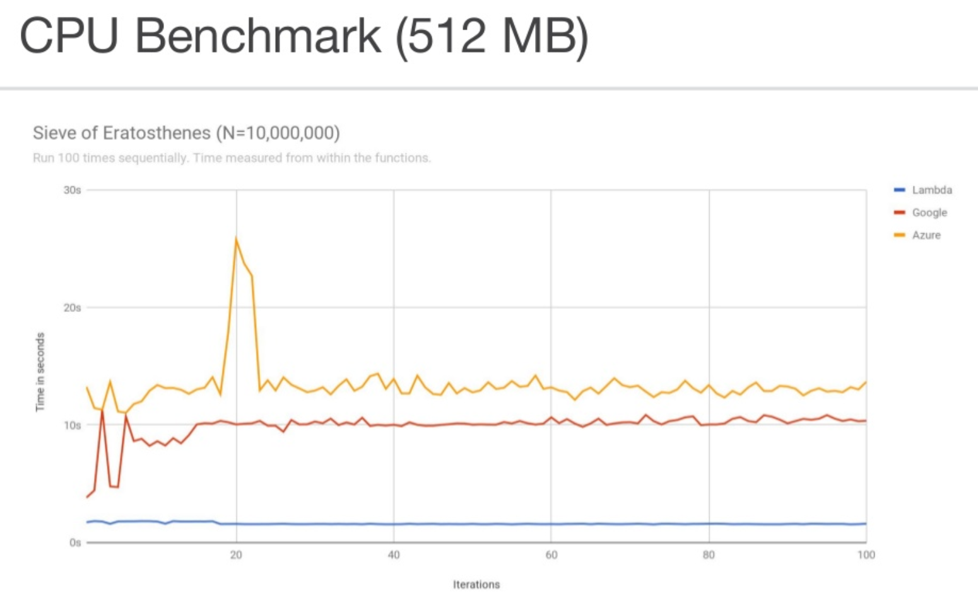

Slide 13
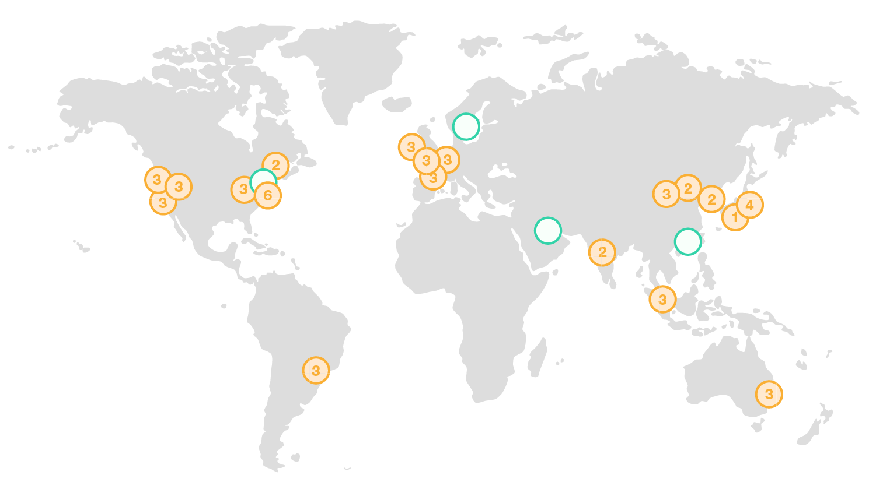
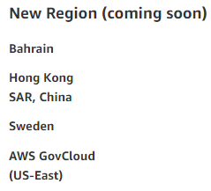
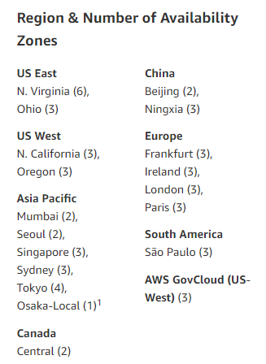
AWS – Amazon Web Services
https://aws.amazon.com/about-aws/global-infrastructure/

Slide 14
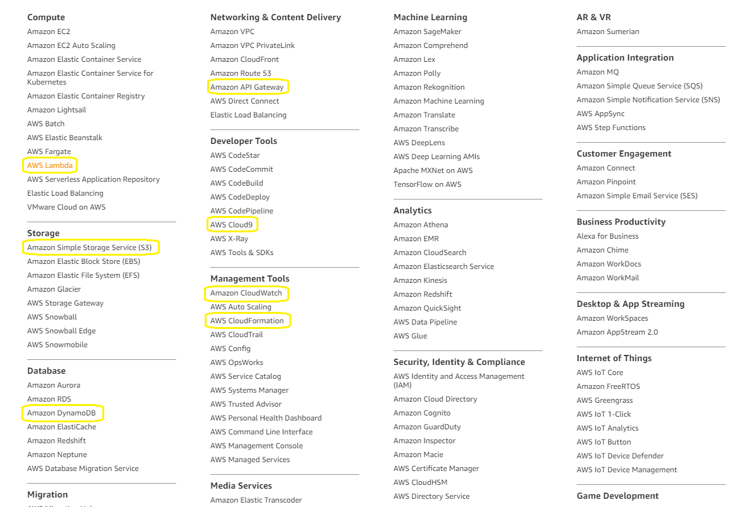
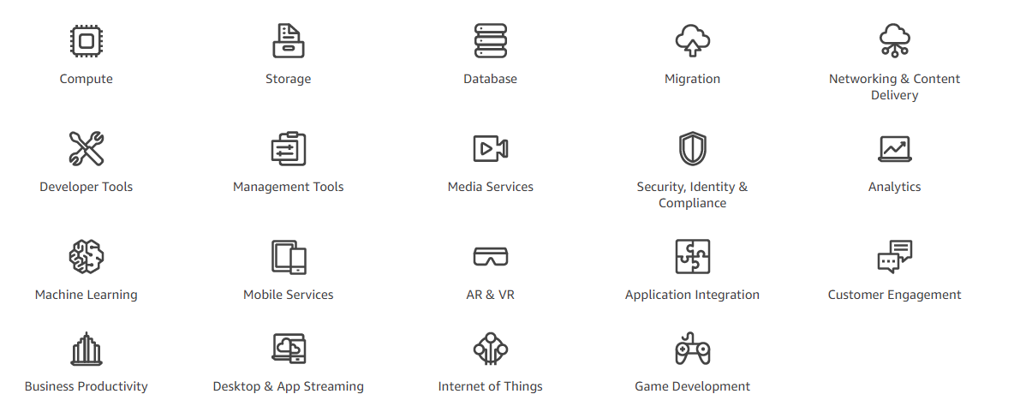
AWS – Wat gaan we gebruiken?
Compute as Utility – Infrastructuur & applicatie-componenten

Slide 15
Gratis? - AWS Free Tier
12 maanden gratis, maandelijks:
API Gateway: 1.000.000 aanroepen
EC2 (Cloud9): 750 h (t2.micro = 1 vCPU, 1GB)
S3: 5GB opslag, 20.000 lees- en 2.000 schrijfacties
Niet-aflopend, maandelijks:
DynamoDB: 25 GB opslag (ca. 20.000.000 verzoeken)
Lambda: 1.000.000 verzoeken, 400.000 GB*s compute
CloudWatch: 5GB log data
Altijd gratis:
IAM – Identity & Access Management
CloudFormation
Cloud9

Slide 16
AWS Lambda Billing
Free Tier / month:
1M requests ($ 0,20 / 1M)
400.000 GB*s ($ 0,00001667 / GB*s)
Time rounded up to 100 ms
Memory configured on Lambda function(128 - 3008 MB)
Free allowance:
3.200.000 seconds @ 128 MB, ~37 d
133.000 second @ 3GB, ~1,5 d

Slide 17
Demo – Node.js
Node.js = Asynchronous server side JavaScript engine
Zie: https://github.com/mnuman/syntouch-node-js
Function skeleton (Node 6):
Three parameters provided:
Event Payload
Execution Context
Callback Function
Export function to expose
exports.handler = (event, context, callback) => {
// your code here..
callback(null, 'Hello from Lambda’);
};
Invoke function, first argument is null when successful!

Slide 18
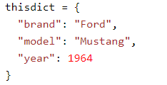
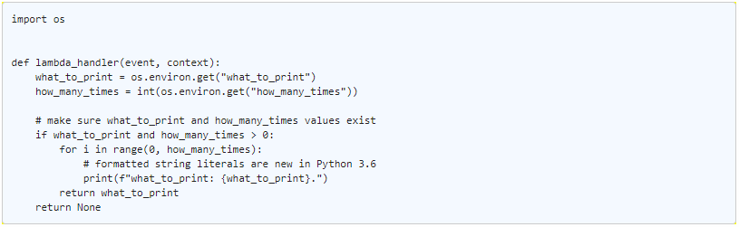
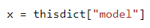
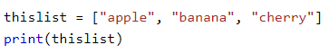
Lambda - Python
Guido van Rossum (CWI) ~1990
Blokgebaseerde, geïnterpreteerde taal
functie definitie, pythonfile.functienaam
event data
context object
externe module

Slide 19

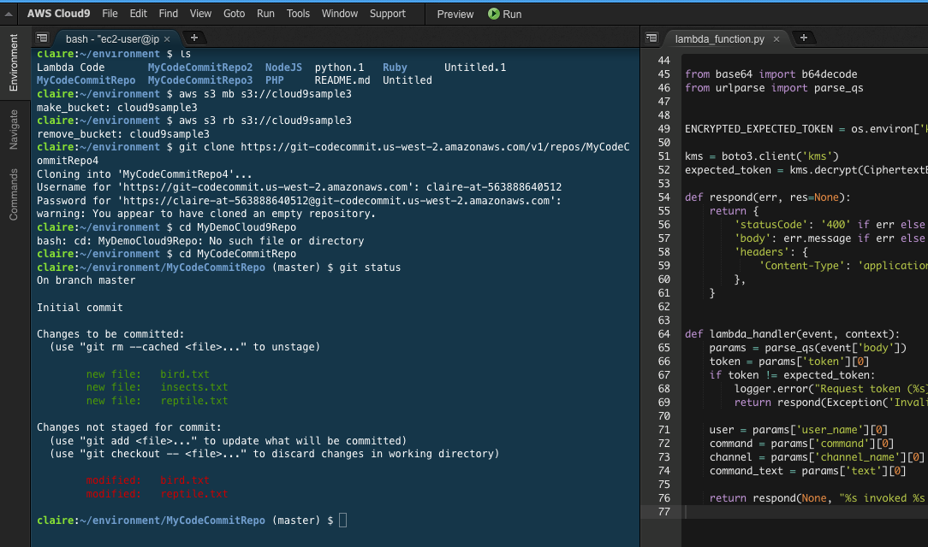
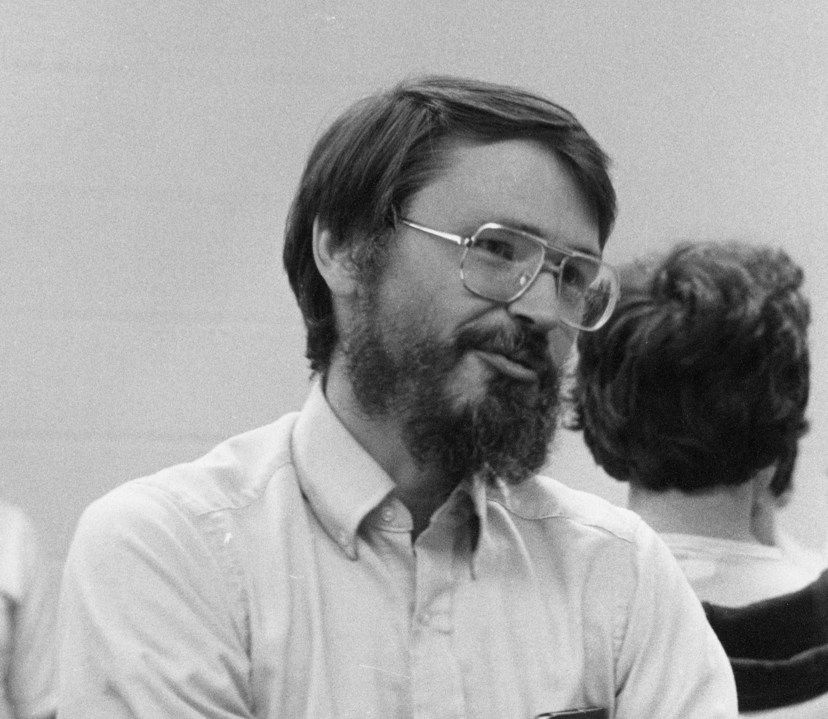



Hands-on
AWS Registratie (8)
Cloud9 (4)
Hello World! (18)
S3 Image manipulation (31)
BeerVotingApp (25)
TwitterBot (4) /YammerBot (10)

Slide 20

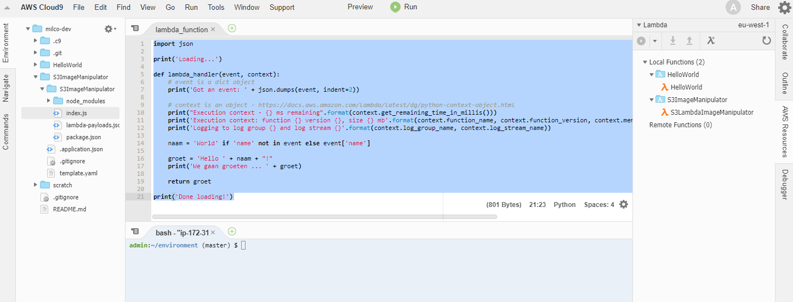
Cloud9
Setup an übercool IDE in the Cloud – Cloud9
Runs on Elastic Compute Cloud (EC2)
Make sure you’re in the correct AWS Region:

Slide 21
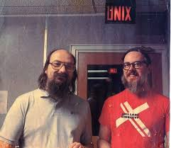
Hello World!
Unavoidable HelloWorld project
function returning “Hello “ + ( name<> null : name : “ World”)
Discover IDE, inspect context/event
Expose function as web API
Cloud9, Python 3
IAM
Lambda
SAM
CloudWatch

Slide 22
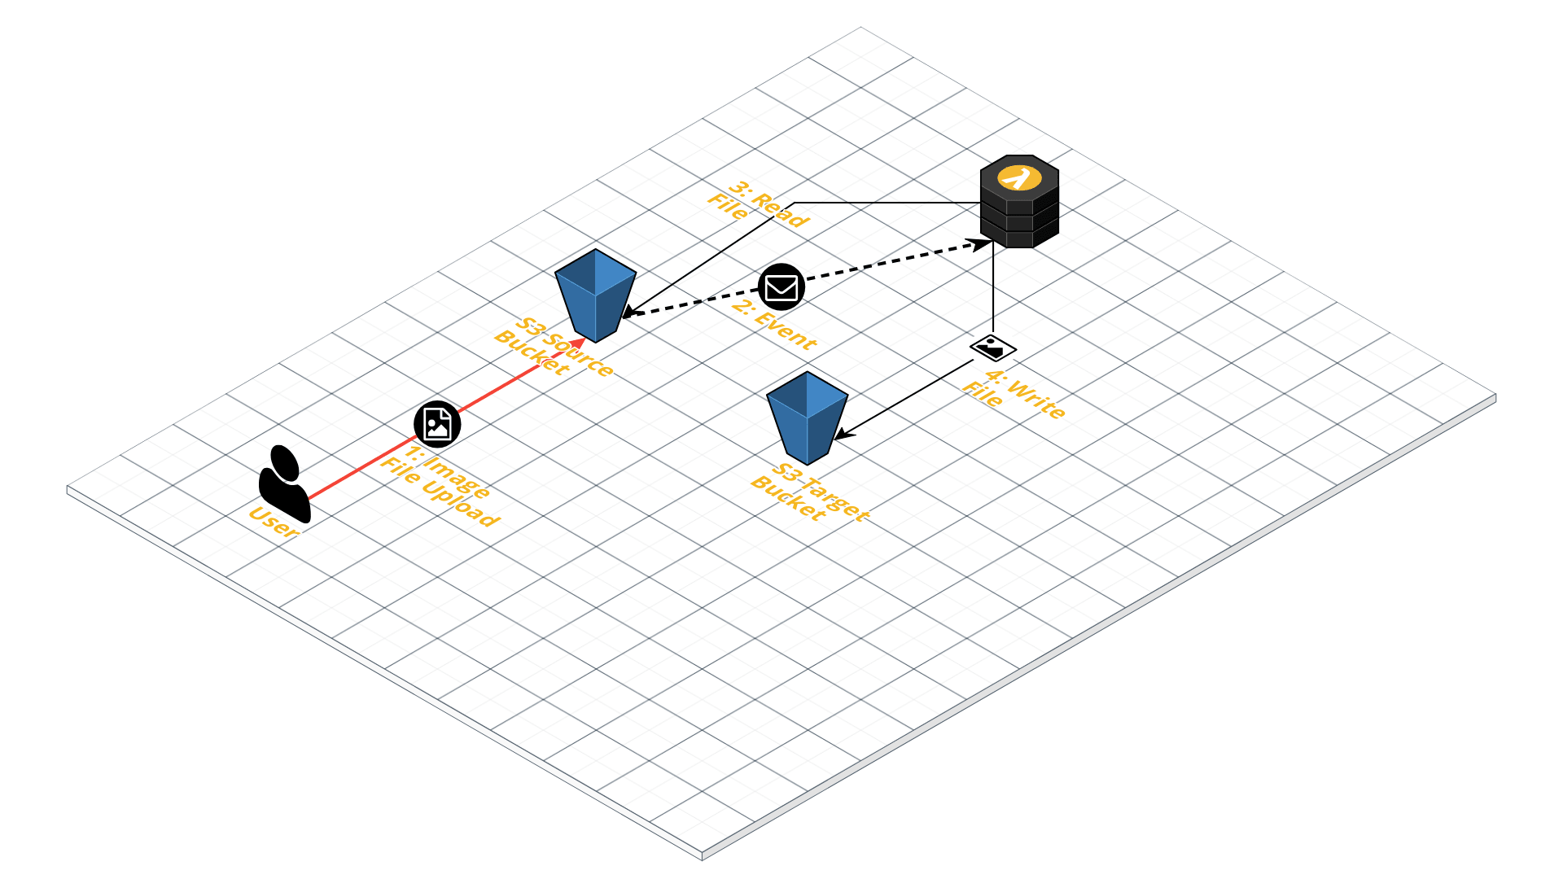
Event-driven Image Manipulation
Upload image file to S3 bucket and transform copied image contents:
Invert
Grayscale
RGB
… (see: https://goo.gl/EdSoTf)
Cloud9, Node.js
S3 – Simple Storage Service
IAM – Identity and Access Management
Lambda
SAM
CloudFormation
CloudWatch

Slide 23
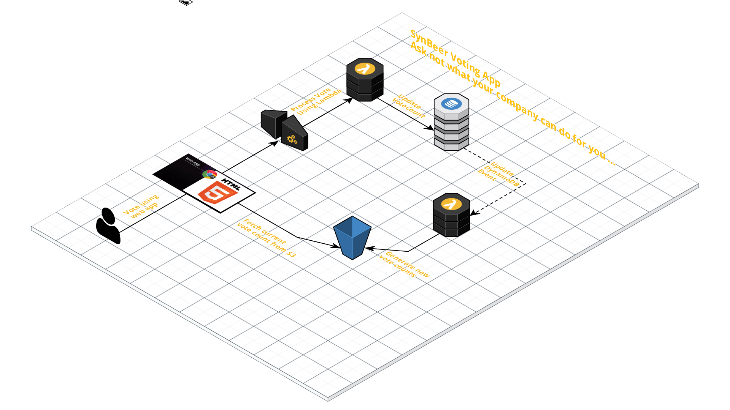
BeerVotingApp
Simple static SPA
hosted from S3
user votes for new SynBier style
app tallies votes
λ → DynamoDB → λ
DynamoDB
Node.js
API Gateway
IAM
Lambda
SAM
CloudWatch

Slide 24
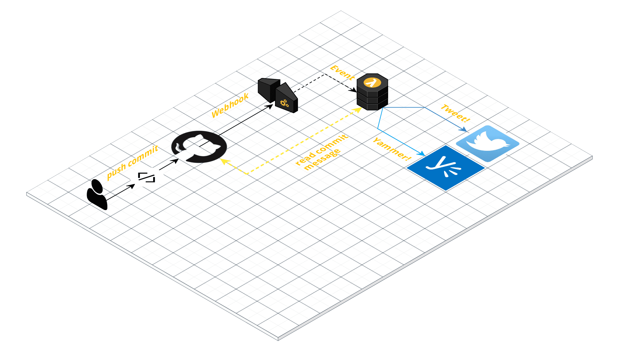
Guys don’t want to commit
Github commits trigger a Tweet – powered by Lambda!
Github account
Twitter developer account
Cloud9, Python 3
IAM
Lambda
API Gateway
GitHub
Twitter Dev Account SynTouch Yammer Account

Slide 25


Slide 26
Workshop Inhoud
Github repository:
https://github.com/mnuman/syntouch-aws-lambda-workshop
https://goo.gl/6iKzZZ
Additional scenario’s:
https://docs.aws.amazon.com/lambda/latest/dg/use-cases.html

Slide 27

Eindhoven
De Zaale 11
5612 AJ Eindhoven
Netherlands
Utrecht
Blok D, Graadt van Roggenweg 328-334
3531 AH Utrecht
Netherlands
Sofia Bulgaria
Nikolay Haytov 12
1113 Sofia
Bulgaria
info@syntouch.nl
www.syntouch.nl

